Slide 1

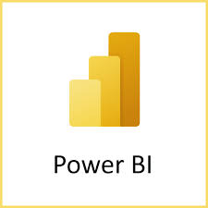

Introduction to powebi and its components

Slide 2
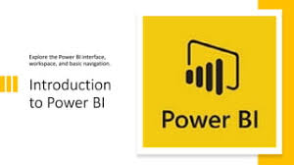
What is Power BI?
Microsoft Power BI is an interactive data visualization software product developed by Microsoft with a primary focus on business intelligence. Developed by: Microsoft Released on: 2011
● Data is crucial for decision-making in areas such as sales, hiring, and goal setting.
● Businesses of all sizes have access to data, but it can be challenging to understand and visualize without a data analytics background.
● Power BI eliminates the complexity of data analysis and visualization.

Slide 3
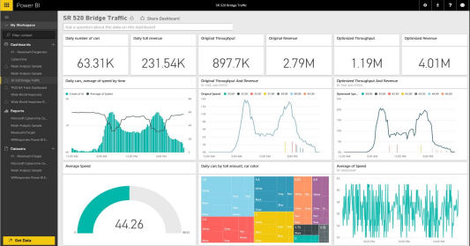
Power BI is a cloud-based business analytics service that enables: ● Power BI connects to various data sources through a secure and user-friendly interface. ● Users can quickly explore and interact with their data. ● Data sources can range from internal databases to cloud-based systems and external sources. ● Power BI simplifies the process of converting raw data into meaningful insights.

Slide 4

Key benefits
● Accessibility: Power BI is designed for both data experts and non-technical users.
● Connectivity: Connect to a wide range of data sources for comprehensive analysis.
● Interactivity: Users can explore and interact with data to uncover hidden patterns and trends.
● Collaboration: Share reports and dashboards with teams for collaborative decision-making.

Slide 5

Power BI key components:
Power BI Desktop: A Windows application for creating and designing reports and visualizations.
Power BI Service: An online SaaS platform for publishing, sharing, and collaborating on Power BI reports and dashboards.
Power BI Mobile Apps: Mobile applications for accessing and interacting with Power BI content on smartphones and tablets.

Slide 6

Power BI Desktop
Power BI Desktop is a powerful Windows application for data modeling, transforming, and visualizing.
Users can connect to various data sources, including databases, spreadsheets, and cloud services.
It offers a rich set of tools for data preparation, such as data shaping, cleaning, and transformation.
Users can create interactive reports and visualizations using a drag-and-drop interface and a wide range of pre-built visuals and custom visuals.

Slide 7

Power BI Service
The Power BI Service is a cloud-based platform for sharing, publishing, and collaborating on Power BI content.
Reports and dashboards created in Power BI Desktop can be published to the Power BI Service.
Users can securely access and view reports through web browsers, with features like data exploration, filtering, and drill-through capabilities.
Collaboration features enable users to share and collaborate on reports, create data-driven alerts, and schedule data refreshes.

Slide 8

Power BI Mobile Apps
Power BI Mobile Apps provide access to Power BI content on mobile devices.
Available for iOS and Android devices, the apps offer a responsive and touch-friendly experience.
Users can view and interact with reports and dashboards, receive data-driven notifications, and share insights on the go.
The apps support offline access, allowing users to access previously viewed content even without an internet connection.

Slide 9
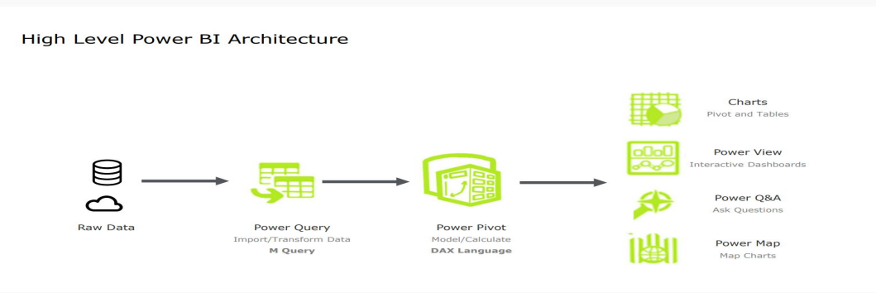
Power BI Architecture

Slide 10
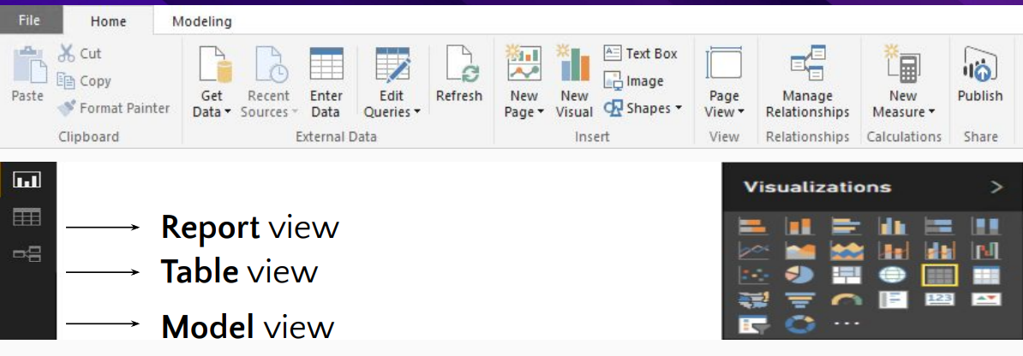
Power BI Desktop views
Power BI Desktop offers three main views for data cleaning and transformation:
Report view: Create queries and design visualizations for sharing.
Table view: Access data in a model format, add measures, create columns, and manage relationships.
Model view: Visualize and manage relationships established in the data model.

Slide 11
Conclusion
In conclusion, Power BI is a transformative business analytics tool that empowers organizations to turn data into actionable insights through its intuitive interface and robust features. By seamlessly integrating with various data sources and offering powerful visualization capabilities, Power BI enables users to create interactive reports and dashboards that facilitate informed decision-making. Its components—ranging from Power BI Desktop to the cloud-based Power BI Service—ensure accessibility and collaboration across teams. As businesses increasingly rely on data-driven strategies, Power BI stands out as a cost-effective and user-friendly solution, making it an essential tool for any organization looking to harness the power of their data. Embracing Power BI can lead to enhanced operational efficiency, improved performance tracking, and ultimately, better outcomes for businesses.

Slide 12
THANKYOU
If you have any questions?
thahliyamist@gmail.com

